Slide 1
MBA 6816 Case Information
Disney

Slide 2
Case Focus
Disney generates revenue through licensing fees paid by companies who sell products using Disney intellectual property like movie characters, movie music, etc..
Which company would your group Disney approach about licensing Disney intellectual property and how would you recommend the licensee market it?

Slide 3
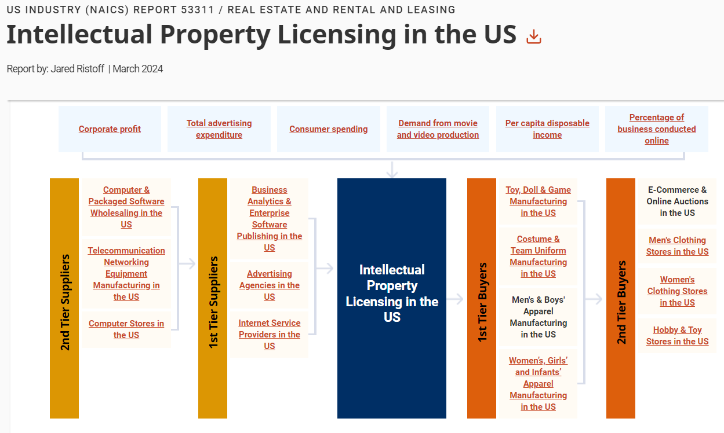
Disney & Licensing Source: IBISWorld - Industry Market Research at UCF Library, https://guides.ucf.edu/az.php?s=12215
Identify two 1st or 2nd tier companies that are vendors at the conferences discuss by Ryan Dourney which meet the criteria he discussed (see slide 8)?
Notes:
Group Response: (Main Options)
-Sun Maid
-Walkers Shortbread
Back up Option:
-Advanced Sunflower LLC

Slide 4
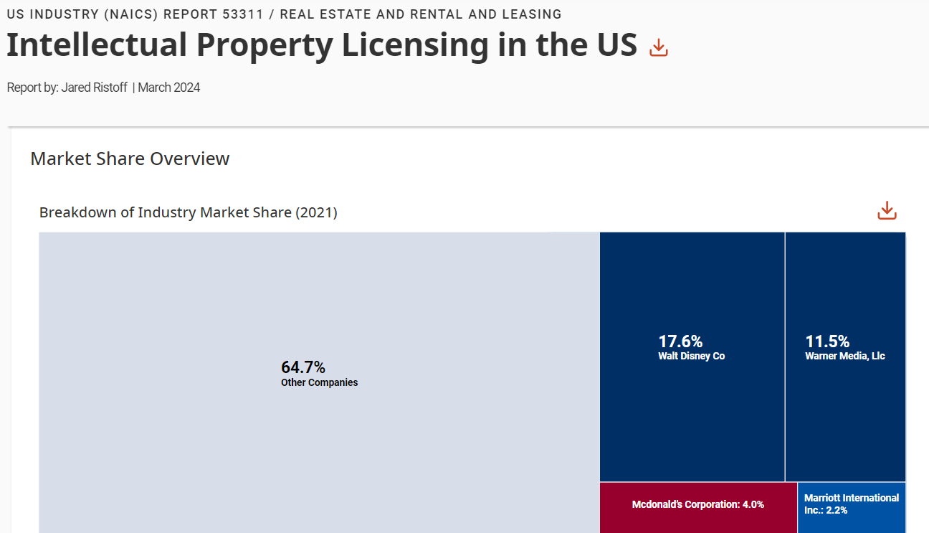
Disney & Licensing Source: IBISWorld - Industry Market Research at UCF Library, https://guides.ucf.edu/az.php?s=12215
What are two strengths of Disney intellectual property relative to the intellectual property of the other top licensing companies?
Notes:
Group Response:
-International Market
-Snacks Branding
-Possible Animation

Slide 5
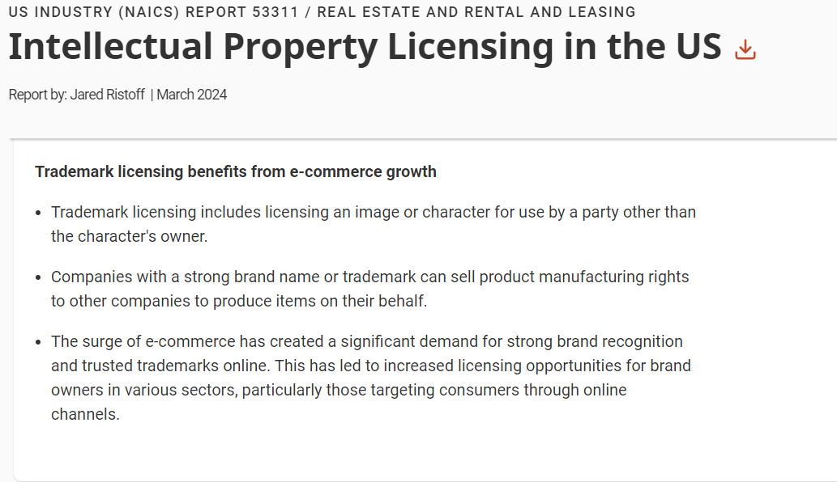
Disney & Licensing Source: IBISWorld - Industry Market Research at UCF Library, https://guides.ucf.edu/az.php?s=12215
What are two strong Disney brands and what makes them strong brands?
Notes:
Group Response:
-Pixar/Brave (Animated Movies)
-Disney Brand Movies

Slide 6
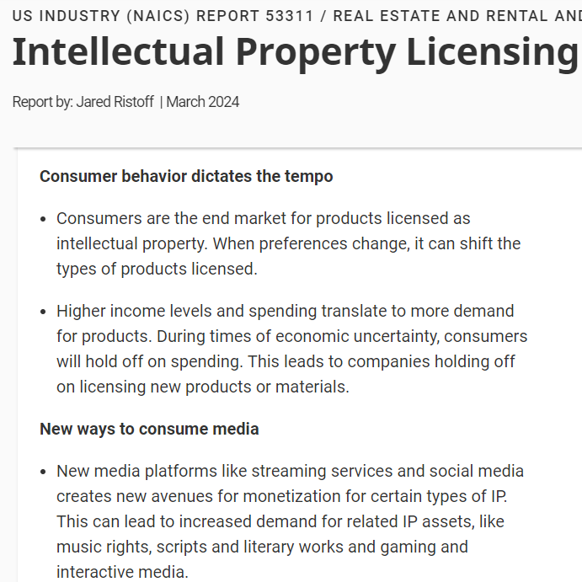
Disney & Licensing Source: IBISWorld - Industry Market Research at UCF Library, https://guides.ucf.edu/az.php?s=12215
What are two important consumer-related trends that have implications for Disney licensing? Why are the trends important?
Notes:
Group Response:
-Brave (Movie) Streaming Service; it would be hitting the current trends of the shift from cable to streaming for younger generations.
-TV/Social Branding: video content would give the most exposure/nostalgia and align with current social media trends within the market. Cooking videos for content that include every character specializing in their culture in the movie and sponsored with the brands to make the food. This will create the biggest return on investment over time.

Slide 7
Recommended Disney Partner and the recommended IP to license to the Partner
What company would you recommend as a licensor of Disney intellectual property and which intellectual property should the company license:
A recommended businesses should come from the list of vendors attending the conferences discussed by Ryan Dourney, Licensing Manager, Consumables Food & Beverage at Disney.
Make sure the business has the criteria discussed by Ryan as key to a successful partnership
Alignment with the Disney brand
Alignment with the Disney licensing guidelines
National or international distribution channel

Slide 8
SWOT overview supporting the recommended Partner .
What are the key strengths of the recommended partner and the opportunities (i.e., positive trends) in the environment that support your recommendation?
What are the key weakness of the recommended partner and the threats (i.e., negative trends) in the environment that should be kept in mind when considering your recommendation?

Slide 9
SWOT overview supporting the recommended Intellection Property .
What are the key strengths of the recommended intellectual property and the opportunities (i.e., positive trends) in the environment that support your recommendation?
What are the key weakness of the intellectual property and the threats (i.e., negative trends) in the environment that should be kept in mind when considering your recommendation?

Slide 10
Recommended marketing mix for the Partner’s marketing of the recommended IP, including the following
Partner’s product using the licensed IP
Discuss which product(s) currently sold by the recommended partner that could use the recommended intellectual property and explain how (e.g., packing of existing product, creation of a line extension, etc.)
Place where the Partner can most effectively sell its product with licensed IP
Discuss which intermediary the partner should use to distribute the product and discuss any access, assistance, assortment, or aesthetic recommendations.
Pricing for the Partner’s product with the licensed IP
Discuss your proposed pricing strategy (e.g., penetration, skimming, bundled, etc.) for the product containing the licensed IP and explain why you have recommended the chosen pricing strategy
Promotion for the Partner’s product with the licensed IP
Discuss your recommended owned, paid, and earned media and provide an example mockup illustrating one of them.

